Slide 1












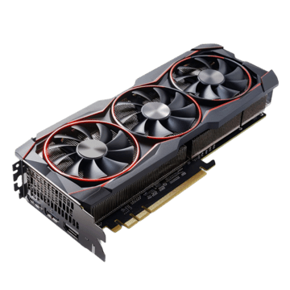
USER
AWS Lightsail server
- 2GBRAM, 2 vCPU, 60GB SSD
- 버지니아, 영역 A (us-east-1a)
DataBase
- NeonDB 서비스(PostgreSQL)
- AWS US East 1 (N. Virginia)
Port: 8000
Port: 443(https)
Enqueue
Presigned URL
Port: 6379
Upload & Download
Celery Broker
Dequeue
Check & Renew
AWS S3
미국 동부(버지니아 북부) us-east-1
volumx-storage-prd
GPU server(Celery Server)
Workstation or RunPods
Nvidia GPU
① Download
Convert (2d -> 3D VR) - pytorch > 12.8
- convert tool: nunif/iw3
② Upload
Notes:
Lightsail에서는 Redis를 host.docker.internal 또는 사설 IP로, Celery 서버에서는 18.215.206.244(공인 IP) 로 접속한다

